Slide 1
HubSpot Sales Hub and Zuper Integration
Transform Your (Services) Customer Experience with Zuper Connected Field Service

Slide 2
Drive Impact For Your FSM Business with HubSpot - Zuper Integration
Best-in-class CRM Ticketing + FSM solution to deliver the best customer experience possible
Improve Operational Efficiency and Drive More Profit
Streamline your Service Operations and Deliver the Best Customer Experience End-to-End
Connect your sales, services and support teams all within one seamless experiencer

Slide 3
HubSpot Service Hub
Integration
Configurable Status & Workflows

Slide 4
HubSpot Sales Hub Integration
Walk though of HubSpot Sales Integration withZuper

Slide 5
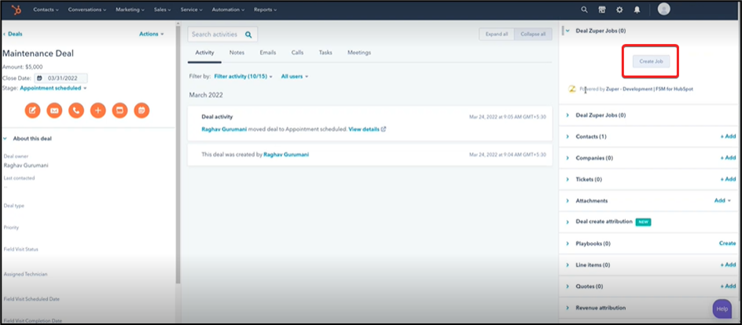
HubSpot
Sales Hub
Integration with Zuper
Easy, Job creation and tracking using HubSpot

Slide 6
HubSpot
Sales Hub
Customer Experience with Zuper
TRIM Landscaping Success With
ZUPER

