Slide 1

Zendesk Integration
The best customer experiences are built with Zendesk.

Slide 2
Zuper – Zendesk Guarantee
Customers can stay informed and Increase workforce utilization by up to 40%.
Operate efficiently and reduce costs by up to 30%.
Reduce service turnaround time by up to 50%.
Increase customer adoption and profitability by up to 35%.
Customers using Zuper are operating more efficiently, saving costs, improving customer satisfaction and growing business.
Customers using Zuper can retain customer for long period by automating communication during the lifecycle of support .

Slide 3
Empower agents to seamlessly schedule Field Service visits.
Pick the date and timeslot depending on the customer’s preference and the availability of the technicians
Geo-coding of the customer address for location intelligence.
Smart scheduling and dispatching to the right technician based on the organization preferences (location, availability, skillset etc.)
Ticket details, customer information, notes, and all related metadata published to the field service work order automatically.
Add assets and parts to work orders

Slide 4
Intelligent and automated communication with customers during the lifecycle of support.
Automated work order booking confirmation via email or text message
Trigger notifications and alerts based on intelligent workflows
Remove the guesswork and notify ETAs to customers when the field technician is on the way.
Enable customers to review and rate the service

Slide 5
Empower your field technicians to operate efficiently and offer the best customer experience.
Automated notifications and alerts for your team on job reminders, SLA violations, and critical alerts.
Capture all the data from the field including pictures, audio, video, and documents, and attach them to the work orders.
Smart routing, actionable insights, work order details, and customer history to improve productivity and efficiency.
Real-time collaboration and syncing of all information to the back office.

Slide 6
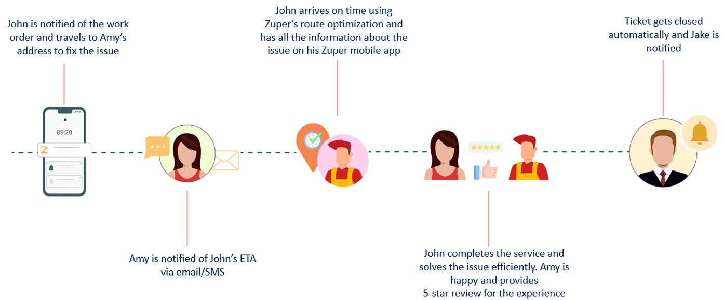
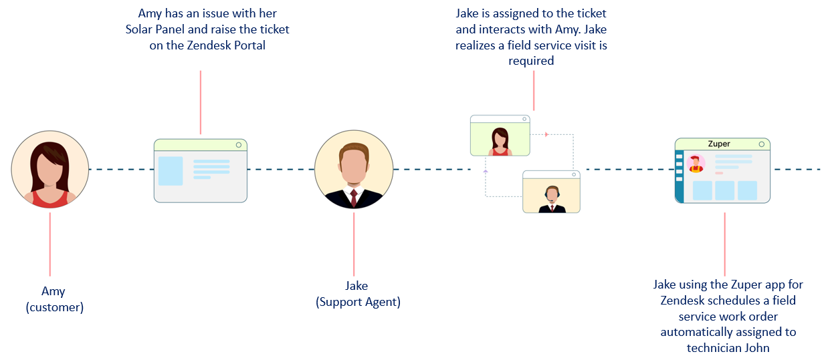
Zuper – Zendesk Workflows

Slide 7
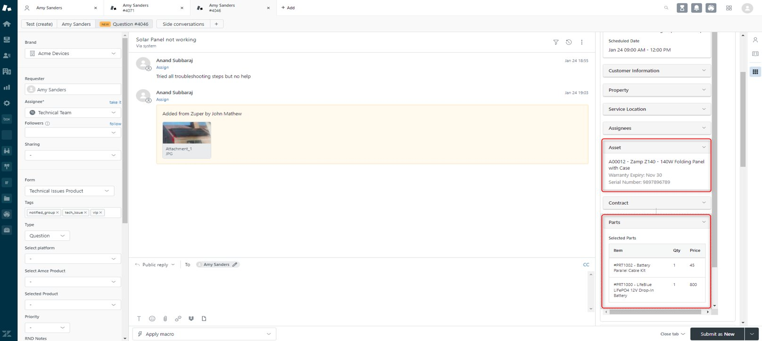
Integrated Asset and Inventory Management

Slide 8
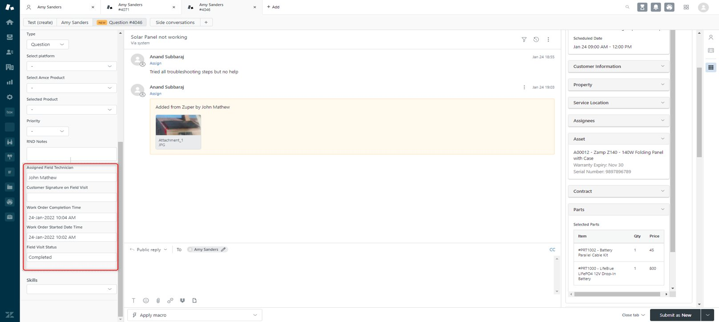
Bidirectional Integration

Slide 9
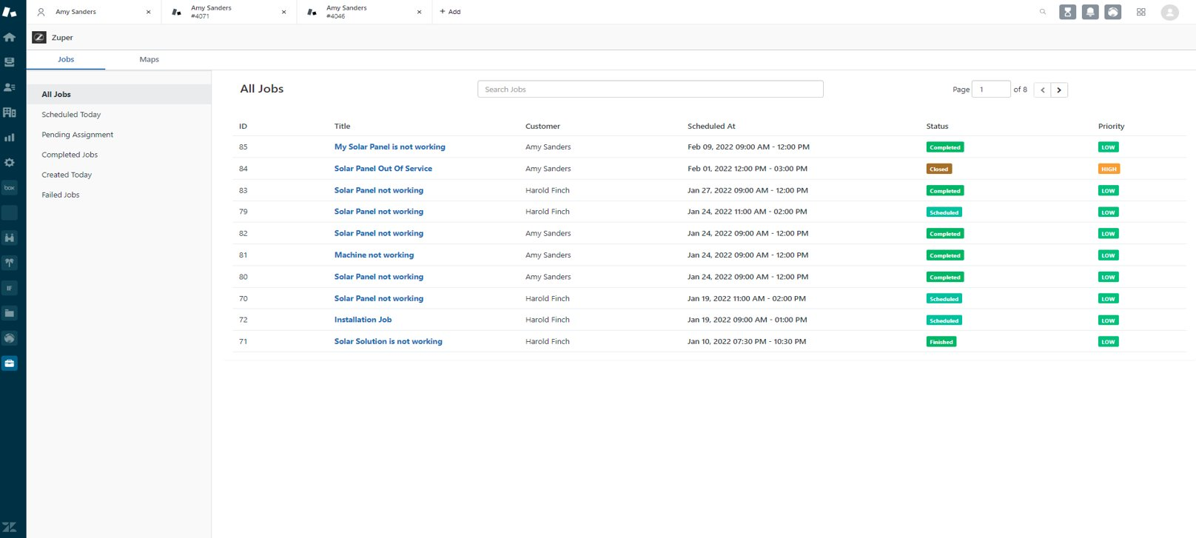
The Zuper app embedded into the Zendesk left menu

Slide 10
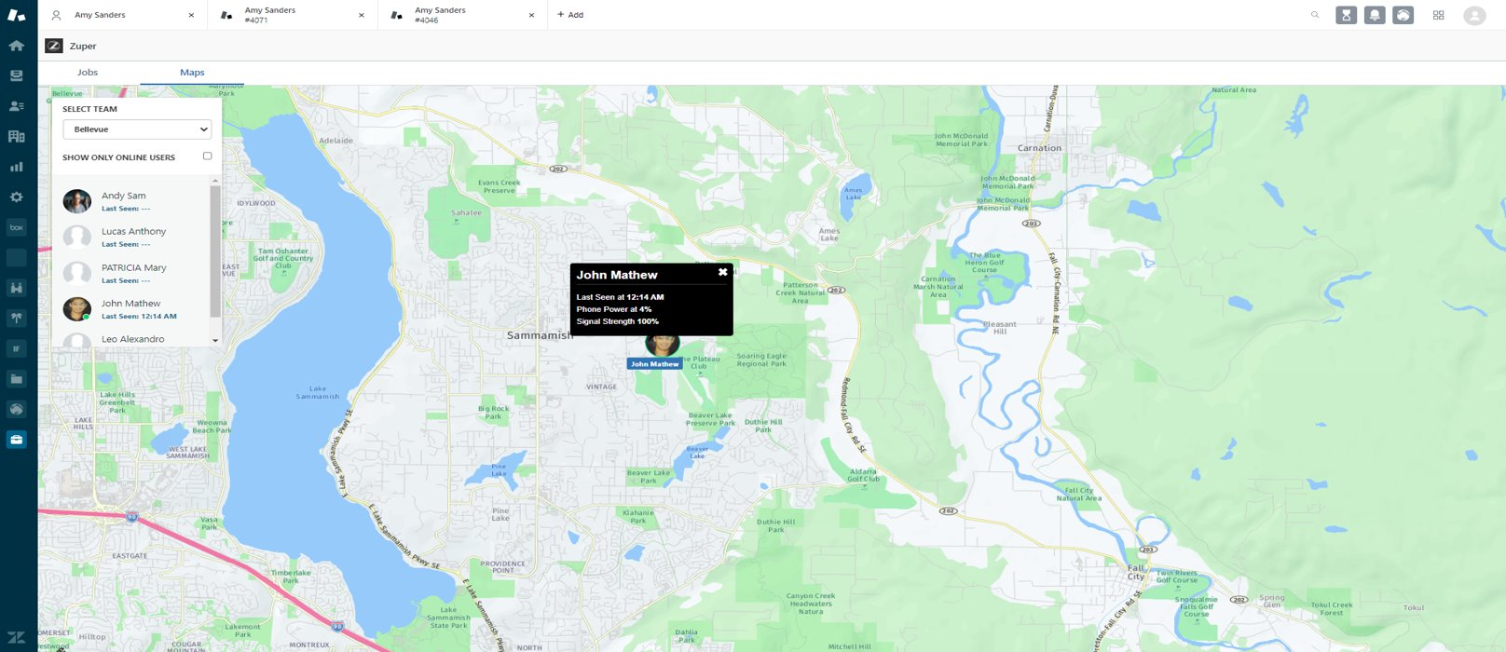
Live tracking of field engineers/technicians from Zendesk

Slide 11
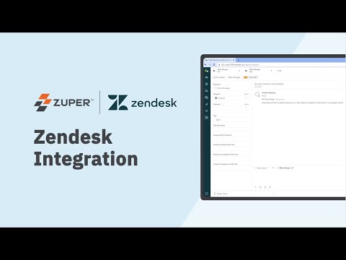
Zendesk-Zuper Integration Feature Overview
Schedule your Zendesk Deals as Service Work Orders automatically in Zuper.

Slide 12
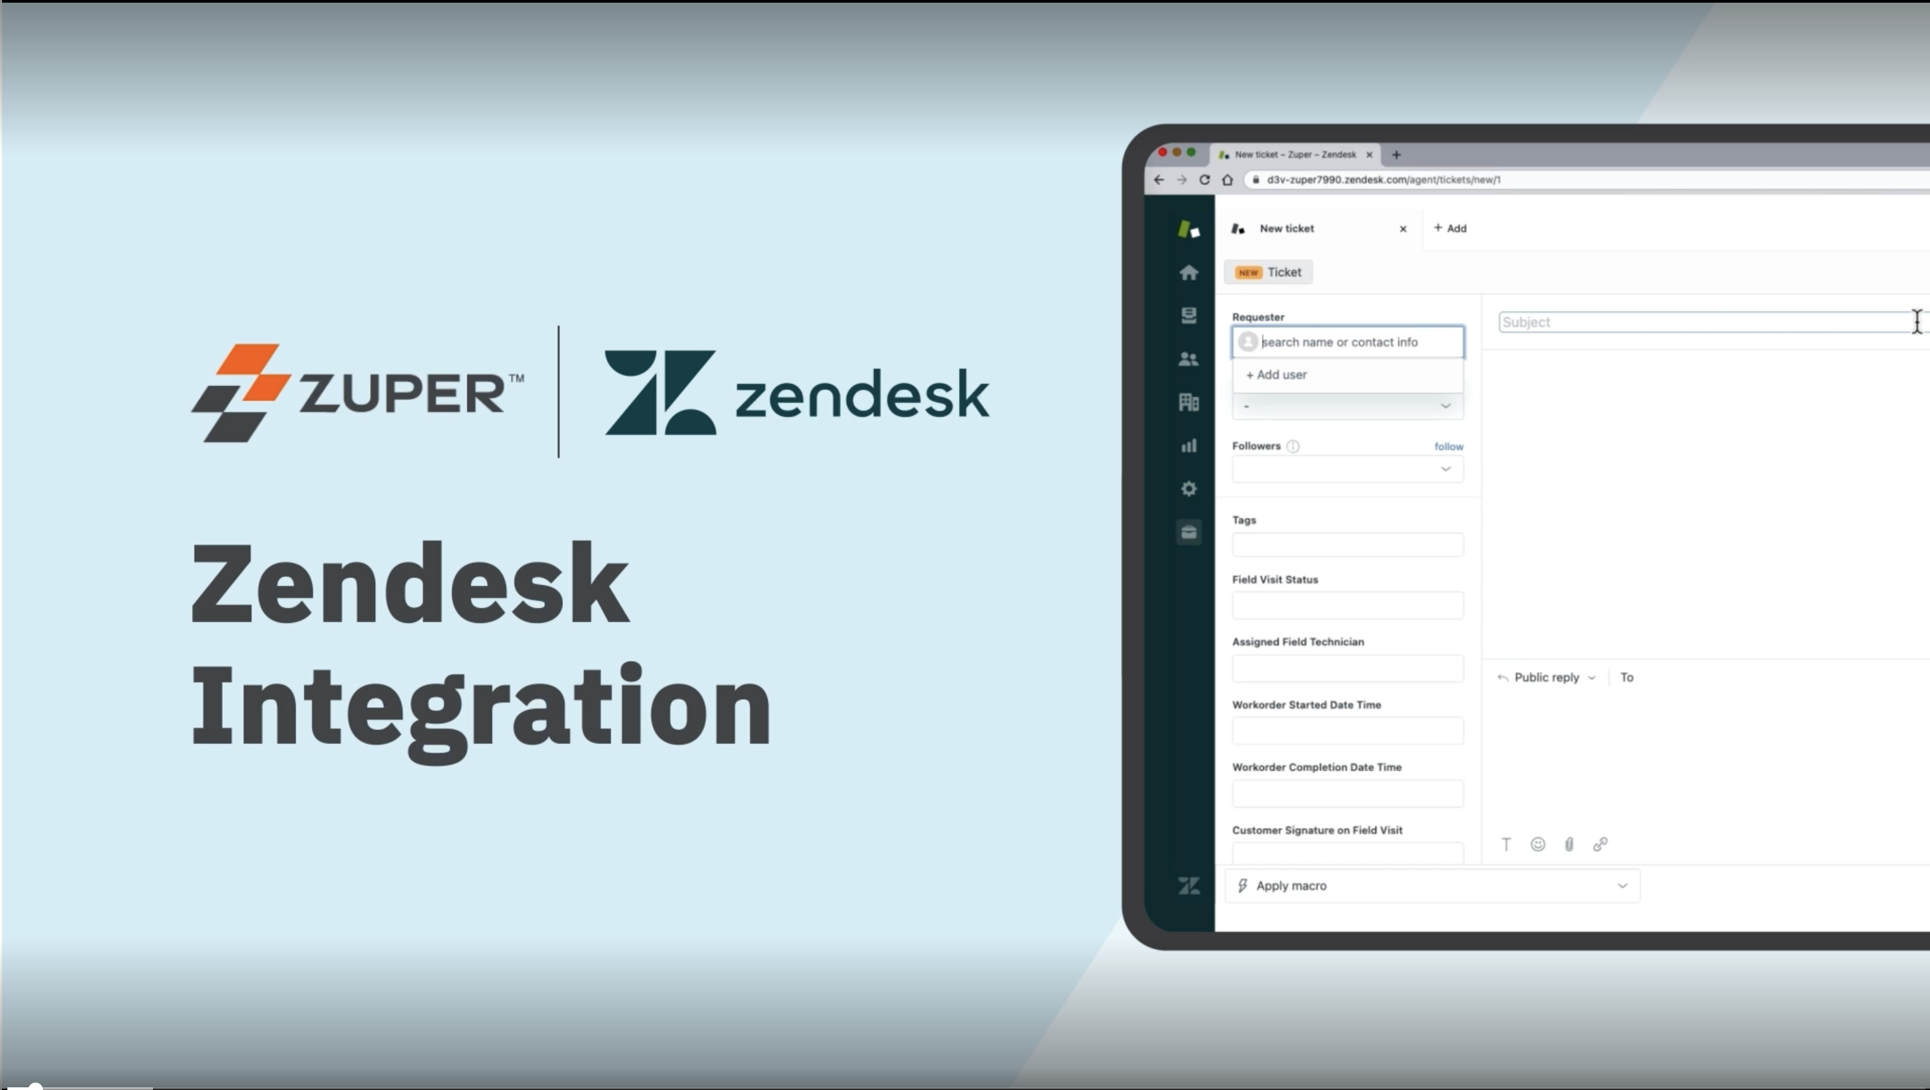

Zendesk-Zuper Integration Demo
Empower your sales and service teams to collaborate better..

Slide 13

Zendesk-Zuper Customers
“Here at All Clean Services, our customers, employees, and vendor partners are at the heart of our business. Our goal is to build strong relationships with our clients and empower our employees and vendor partners to be successful in their roles servicing our clients.
While providing solutions to customers and managing our teams across the United States, we are very eager to commence this partnership with Zuper. Our management team is most excited about the collaboration between Zuper and Zendesk, which combines Zuper’s powerful workforce management platform with Zendesk’s mastered customer support ticketing software.
These integrated tools will help improve our existing customers’ experience and support our future growth. We all share the same vision: To provide the best possible customer experience.”
– Brian Beckham, Chief Administrative Officer, All Clean Services

